Slide 1
Business Intelligence and Business Analytics (H9BIBA)

Slide 2
Module Content
Intelligent Enterprises
Agile Enterprises, Operating Strategies, Continuous Improvement Programs
Enterprise Systems
Evolution – MRP, CL MRP, MRP II, ERP, ES Packages, Balanced Scorecard
BI and Dashboards
Views v Reports, Types of Dashboards, Advantages of Dashboards, The Funnel
Consumer Behaviour models
Behaviourist v Cognitivist, Lawson’s, EKB, and Howard and Sheth’s models
Operational CRM Systems
Overview and Demo of a commercial system such as Microsoft Dynamics CRM
Implementing Enterprise BI systems
Data Warehousing and Data Marts, Data mining, Online Analytical Process (OLAP)
Implementing CRM systems
Fit-Gap Analysis, Integration with Heterogeneous systems, Data integration, Information Lifecycle Management, Data protection, security and ethical considerations
Customer-Centric Enterprise with CRM
Customer Experience, Customer Loyalty, Customer Relationships, Customer Life Cycle, Customer Value Management
Customer-Responsive Enterprise with SCM
Supply Chain Management, Customer-Responsive Management, B-Webs, Activity Costing techniques
Renewing Enterprise with PLM
Components and Advantages of PLM, Porter’s Framework, Product Life Cycle

Slide 3
Today
Customer-Responsive Enterprise with SCM
Supply Chain Management, Customer-Responsive Management, B-Webs, Activity Costing techniques

Slide 4
SUPPLY CHAIN MANAGEMENT
A supply chain consists of all parties involved, directly or indirectly, in fulfilling a customer requirement.
All facilities, functions, activities, associated with flow and transformation of goods and services from raw materials to customer, as well as the associated information flows.
An integrated group of processes to “source,” “make,” and “deliver” products

Slide 5
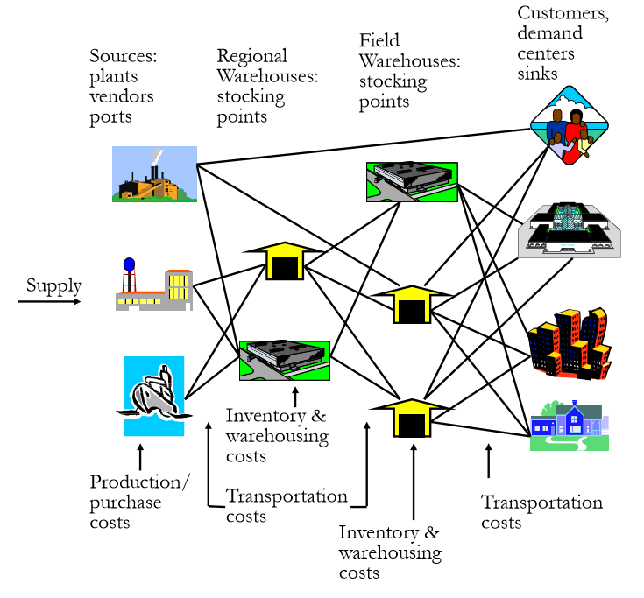

Slide 6
SCM continued…
Definition: Supply Chain Management is primarily concerned with the efficient integration of suppliers, factories, warehouses and stores so that merchandise is produced and distributed in the right quantities, to the right locations and at the right time, and so as to minimize total system cost subject to satisfying customer service requirements.
Supply chain management (SCM) is the management of the flow of goods
The goal or mission of supply chain management can be defined using Mr. Goldratt’s words as “Increase throughput while simultaneously reducing both inventory and operating expense.

Slide 7
SCM continued…
Supply chain management has been defined as the "design, planning, execution, control, and monitoring of supply chain activities with the objective of creating net value, building a competitive infrastructure, leveraging worldwide logistics, synchronizing supply with demand and measuring performance globally.

Slide 8
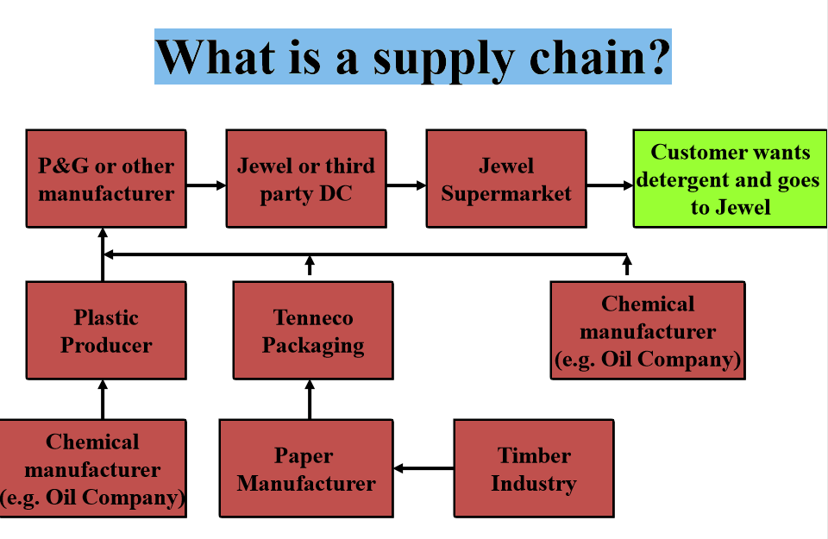
SCM Overview

Slide 9
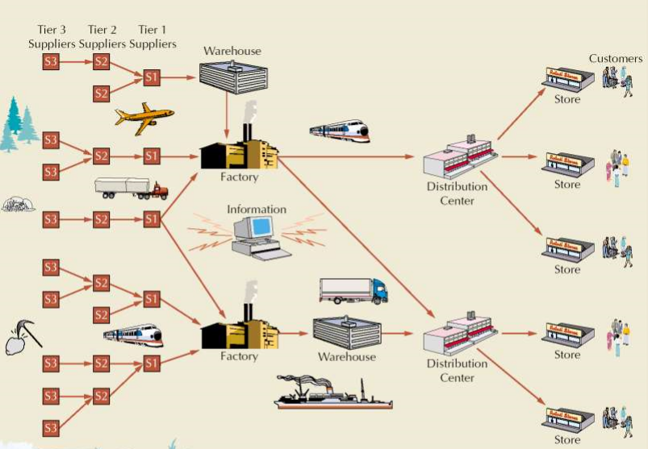
Supply Chain Example

Slide 10
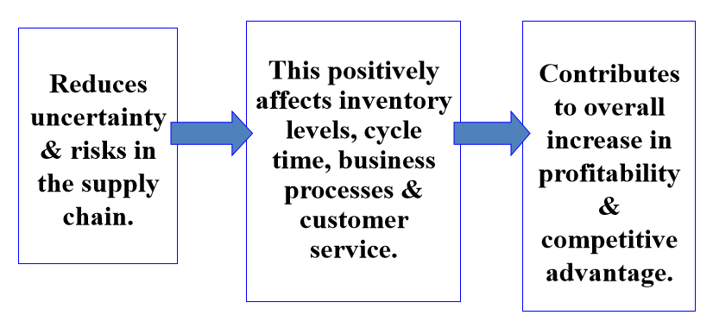
Benefits of SCM

Slide 11
SUPPLY CHAIN STAGES
Customers
Retailers
Wholesalers/Distributors
Manufacturers
Component/ Raw material supplier
Note:– It is not compulsory that all the stages should be present in a supply chain.

Slide 12

What is SCM?
A set of approaches used to efficiently integrate
Suppliers
Manufacturers
Warehouses
Distribution centers
So that the product is produced and distributed
In the right quantities
To the right locations
And at the right time
System-wide costs are minimized and
Service level requirements are satisfied

Slide 13
History of Supply Chain Management
1960’s - Inventory Management Focus, Cost Control.
1970’s - MRP& OM - Operations Planning.
1980’s - MRPII, JIT - Materials Management, Logistics.
1990’s - SCM - ERP - “Integrated” Purchasing, Financials, Manufacturing, Order Entry.
2000’s - Optimized “Value Network” with Real-Time Decision Support; Synchronized & Collaborative Extended Network for SCM.

Slide 14
Objectives
Satisfy the customer needs.
Maximize the overall value generated.
Increase supply chain surplus.
High supply chain profitability.

Slide 15
SUPPLY CHAIN DECISIONS
Design > planning > execution > control > monitoring.
Ensure effective flow of goods and information.
Clusters of store near the distribution center.
Collaboration with suppliers.
Active efforts to steer customer at real time.
Centralized manufacturing.
Worth of inventory.
Manage cash flow.
Should be flexible.

Slide 16
DECISION PHASES IN SUPPLY CHAIN
Supply chain strategy or design
How to structure for next several years.
What is the chain configuration.
How resources allocated.

Slide 17
DECISION PHASES IN SUPPLY CHAIN CONT…
What process each stage will perform.
Outsourcing.
In house functions.
Locations and capacities of production and warehouses.
Mode of transportation.
Type of information system

Slide 18
DECISION PHASES IN SUPPLY CHAIN CONT…
2. Supply chain planning
for several months.
Forecast for the coming year.
Analyses demand in different markets.
Which market? Location?

Slide 19
DECISION PHASES IN SUPPLY CHAIN CONT…
Sub-contracting.
Inventory policies.
Timing.
Size of marketing.
Price promotions

Slide 20
DECISION PHASES IN SUPPLY CHAIN CONT…
3. Supply chain operations
weekly or daily operation decisions.
Individual customer orders.
Allocation of inventory and production.
Set dates for activities

Slide 21
DECISION PHASES IN SUPPLY CHAIN CONT…
Generate lists for warehouses.
Allocation of shipments.
Schedules of trucks.

Slide 22
PROCESS VIEWS OF SUPPLY CHAIN
CYCLE VIEW
Process divided into series of cycles.
Each cycle occurs at the interface between two successive stages of the supply chain.
Customer order cycle.
Replenishment cycle.
Manufacturing cycle.
Procurement cycle.

Slide 23
Cycle View Cont…
A cycle view of supply chain clearly define the process involved and the owners of each process.
This view is very useful when considering operational decisions because it specifies the roles and responsibilities of each member of supply chain and the desired outcome of each process

Slide 24
PUSH PULL VIEW OF SUPPLY CHAIN
Divided in to two categories
Executed in response to a customer order(pull process).
Executed in anticipation of customer orders(push process).

Slide 25
Drivers of supply chain performance
Aim responsiveness and efficiency at lowest possible cost.
Drivers are set to improve the supply chain performance.
Facilities.
Inventory.
Transportation.
Information.
Sourcing.
Pricing

Slide 26
Customer-Responsive Management
Seven ways to provide more responsive customer service
Stop making excuses. It’s easy to excuse a delayed response because you were buried under an avalanche of work or something unexpected came up. Making excuses can also make being unresponsive a self-fulfilling prophecy. If you want to find ways to respond faster, don’t try to convince yourself that a delayed response is okay.
Get a system (and use it). Our memories are notoriously poor at reminding us to return a call or send an email. (Little sticky notes on your computer are equally bad.) Get a system to organize and track customer communication, such as Customer Relationship Management (CRM) software, Microsoft Outlook, even an old-fashioned memo pad.
Keep your email inbox clean. The typical email inbox is overflowing with messages. Important emails get overlooked and ultimately forgotten because the inbox is so crowded. Keep your inbox clean by making decisions about each message you receive. Respond immediately to simple inquires and create various folders to file away other messages for future reference.

Slide 27
Continue …
Manage expectations. Customers expect a rapid response, but they’re often very forgiving if they know up front it can take a little longer than normal. When things get busy, set up an automatic response to incoming email send a quick note to let people know when you’ll get back to them.
Monitor all channels. Customers will often contact a company via multiple channels if one channel is unresponsive. For instance, they might Tweet about their problem if they don’t get a quick response to an email. You can avoid this by making sure you monitor all of your customer service channels on a regular basis. There are even software programs like Hootsuite that can make it easy to monitor and respond to multiple social media streams all in one place.
Choose the right channel. Each of communication has distinct advantages and disadvantages, so choosing the right channel can speed things up. For example, it may be easier to schedule a phone call or a video chat with customers experiencing difficult problems rather than go back and forth via email.
Align your schedule. Responsiveness often comes down adjusting your schedule to peak times. Keep track of when you receive the most phone calls, emails, and other messages? Adjust your schedule accordingly so you can put aside less urgent work during those times and respond faster.

Slide 28
Activity-Based Costing (ABC)
Activity-based costing (ABC) is mostly used in the manufacturing industry since it enhances the reliability of cost data, hence producing nearly true costs and better classifying the costs incurred by the company during its production process.
ABC is used to get a better grasp on costs, allowing companies to form a more appropriate pricing strategy.

Slide 29
ABC Continue …
Activity-based costing (ABC) is a method of assigning overhead and indirect costs—such as salaries and utilities—to products and services.
The ABC system of cost accounting is based on activities, which are considered any event, unit of work, or task with a specific goal.
An activity is a cost driver, such as purchase orders or machine setups.
The cost driver rate, which is the cost pool total divided by cost driver, is used to calculate the amount of overhead and indirect costs related to a particular activity.

Slide 30
The ABC calculation
Identify all the activities required to create the product.
Divide the activities into cost pools, which includes all the individual costs related to an activity—such as manufacturing. Calculate the total overhead of each cost pool.
Assign each cost pool activity cost drivers, such as hours or units.
Calculate the cost driver rate by dividing the total overhead in each cost pool by the total cost drivers.
Divide the total overhead of each cost pool by the total cost drivers to get the cost driver rate.
Multiply the cost driver rate by the number of cost drivers.

Slide 31
Thank you!

